Slide 1

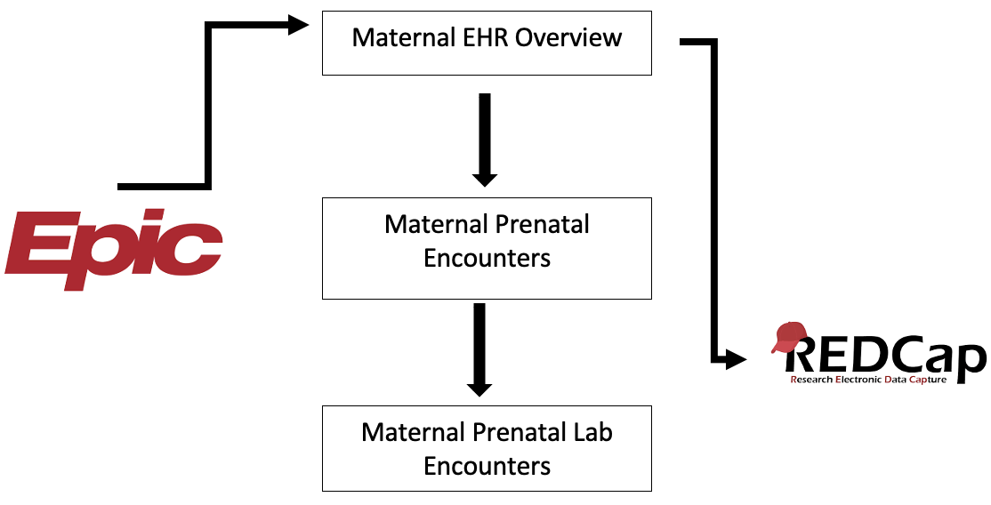


COMPARISON OF ROUTINELY COLLECTED PERINATAL ELECTRONIC HEALTH DATA WITH LONGITUDINAL CLINICAL RESEARCH DATA FROM THE BREASTFEEDING AND EARLY CHILD (BEACH) STUDY
Health Outcomes &
Biomedical Informatics
College of Medicine
Abigail Vlasak, Nisha Chachad, Ke Xu, Magda Francois, Dominick J. Lemas, PhD.
Introduction
Results
Breastfeeding populations are difficult to recruit.
The BEACH study population involves 4 arms with breastfeeding females.
Participant data was largely extracted from electronic health records.
Electronic health records (EHRs) have created new opportunities for researchers to collect clinical data on research participants using routinely collected EHR data.
Table 1. Descriptive Characteristics of EHR participants
 | NW | OW | Ob
Delivery Location
Mode of Delivery
Gestational Age
Infant Sex
Infant Weight
Figure 1. Summary of UF Health EHR data extraction
Objective
Demonstrate the value of using an electronic health record for streamlined database variable entry.
Compare self-reported BEACH survey BMI with EHR BMI.
Methods
Table 2. Comparison of maternal BMI in EHR and BEACH study
 | NW | OW | Ob
Maternal BMI
UF Health
BEACH
Conclusion
.
The electronic health record can be a useful source of data extraction to allow better analysis of results.
Directly querying EPIC for the data endpoints that had to be manually entered in a separate database in our study. Direct EHR query may be the most efficient way to collect subject’s metrics and study endpoints in the future.
Train other research assistants on the data inventory process
Further analysis of self reported and EPIC inputted data points using data informatic software
Acknowledgements
We are grateful to our funding source, NIDDK (K01DK115632), University Scholars Program, the University of Florida Clinical and Translational Science Institute [UL1TR001427], and our amazing participants.

